Slide 1

MATH30
Probability and Statistics

Slide 2
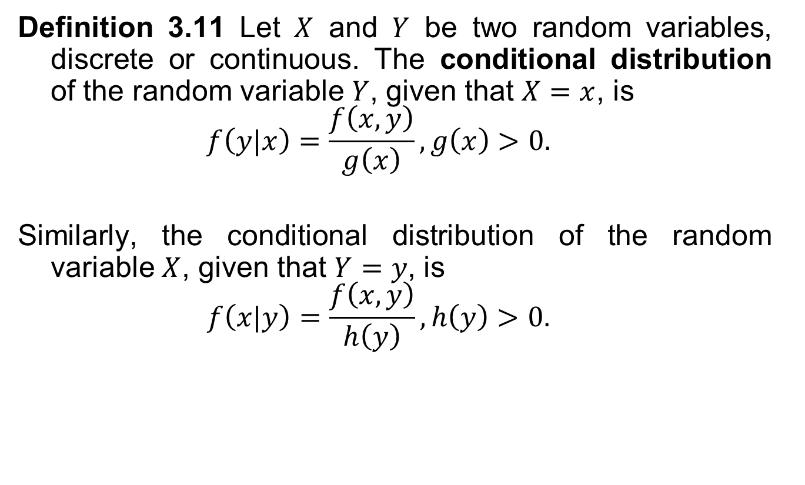
Conditional Distribution
Definition 3.11 Let $X$ and $Y$ be two random variables, discrete or continuous. The conditional distribution of the random variable $Y$, given that $X=x$, is
$$f\left(y|x\right)=\frac{f\left(x, y\right)}{g\left(x\right)}, g\left(x\right)>0.$$
Similarly, the conditional distribution of the random variable $X$, given that $Y=y$, is
$$f\left(x|y\right)=\frac{f\left(x, y\right)}{h\left(y\right)}, h\left(y\right)>0.$$

Slide 3
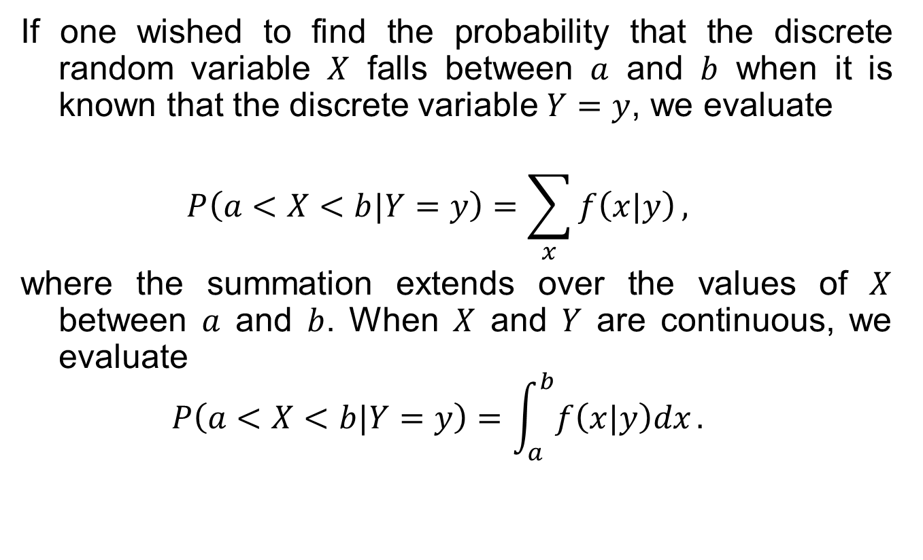
Conditional Distribution
If one wished to find the probability that the discrete random variable $X$ falls between $a$ and $b$ when it is known that the discrete variable $Y=y$, we evaluate
$$P\left(a<X<b|Y=y\right)=\sum_{x}{f\left(x|y\right)},$$
where the summation extends over the values of $X$ between $a$ and $b$. When $X$ and $Y$ are continuous, we evaluate
$$P\left(a<X<b|Y=y\right)=\int_{a}^{b}{f\left(x|y\right)dx}.$$

Slide 4
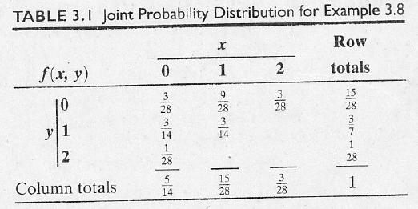

Conditional Distribution
Example 3.12 Referring to Example 3.8, find the conditional distribution of $X$, given that $Y=1$, and use it to determine $P\left(X=0|Y=1\right)$.

Slide 5
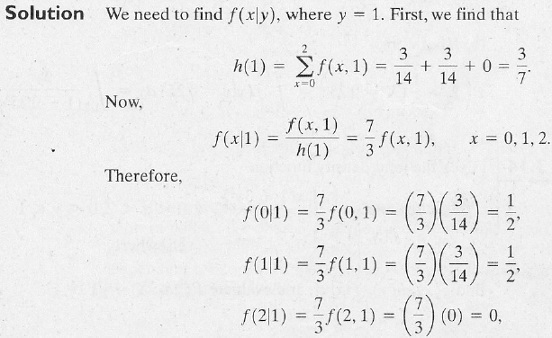
Conditional Distribution

Slide 6
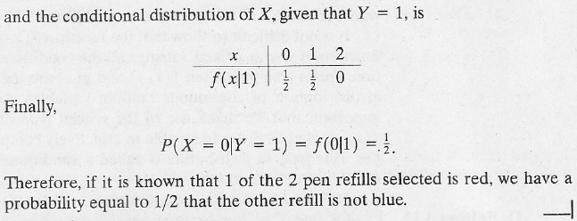
Conditional Distribution

Slide 7
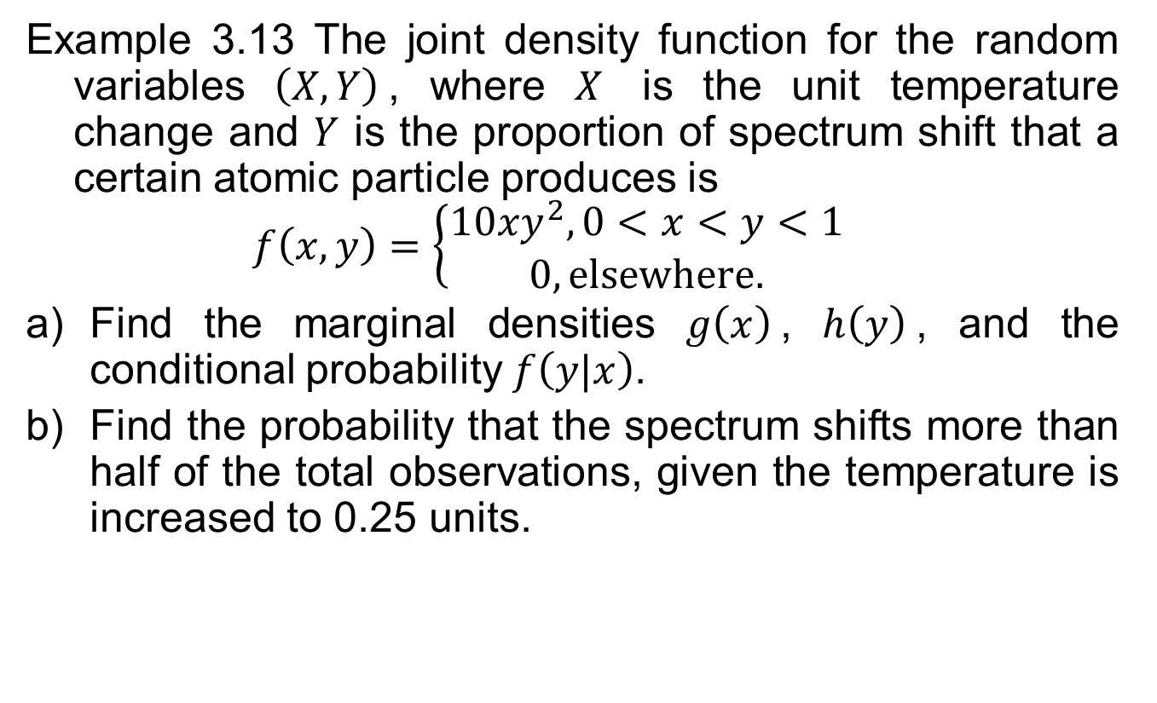
Conditional Distribution
Example 3.13 The joint density function for the random variables $\left(X, Y\right)$, where $X$ is the unit temperature change and $Y$ is the proportion of spectrum shift that a certain atomic particle produces is
$$f\left(x, y\right)=\left\{\begin{aligned}10xy^{2}, 0<x<y<1 \\ 0, elsewhere.\end{aligned}\right.$$
Find the marginal densities $g\left(x\right)$, $h\left(y\right)$, and the conditional probability $f\left(y|x\right)$.
Find the probability that the spectrum shifts more than half of the total observations, given the temperature is increased to 0.25 units.

Slide 8
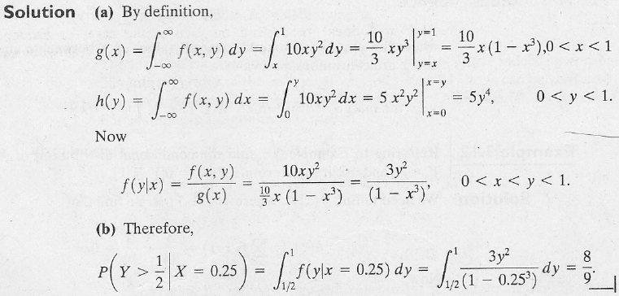
Conditional Distribution

Slide 9

Conditional Distribution
Example 3.14 Given the joint density function
$$f\left(x, y\right)=\left\{\begin{aligned}\frac{x\left(1+3y^{2}\right)}{4}, 0<x<2, 0<y<1 \\ 0, elsewhere,\end{aligned}\right.$$
find $g\left(x\right)$, $h\left(y\right)$, $f\left(x|y\right)$, and evaluate $P\left(\frac{1}{4}<X<\frac{1}{2}|Y=\frac{1}{3}\right)$.

Slide 10
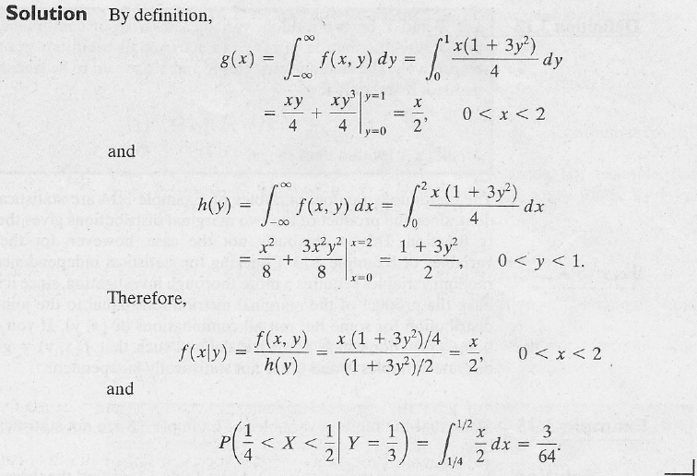
Conditional Distribution

Slide 11
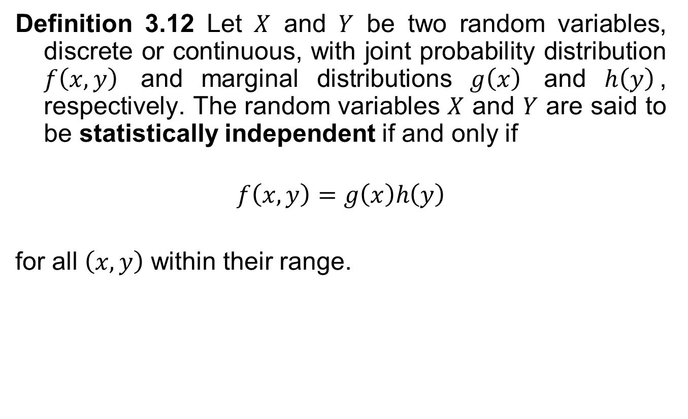
Statistical Independence
Definition 3.12 Let $X$ and $Y$ be two random variables, discrete or continuous, with joint probability distribution $f\left(x, y\right)$ and marginal distributions $g\left(x\right)$ and $h\left(y\right)$, respectively. The random variables $X$ and $Y$ are said to be statistically independent if and only if
$$f\left(x, y\right)=g\left(x\right)h\left(y\right)$$
for all $\left(x, y\right)$ within their range.

Slide 12
Statistical Independence
Example 3.15 Show that the random variables of Example 3.8 are not statistically independent.

Slide 13
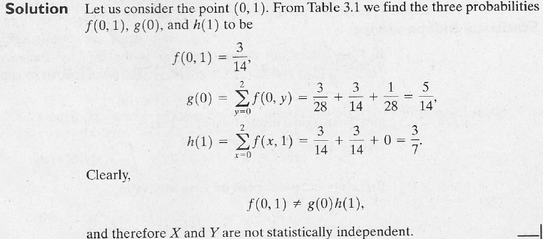
Statistical Independence

Slide 14
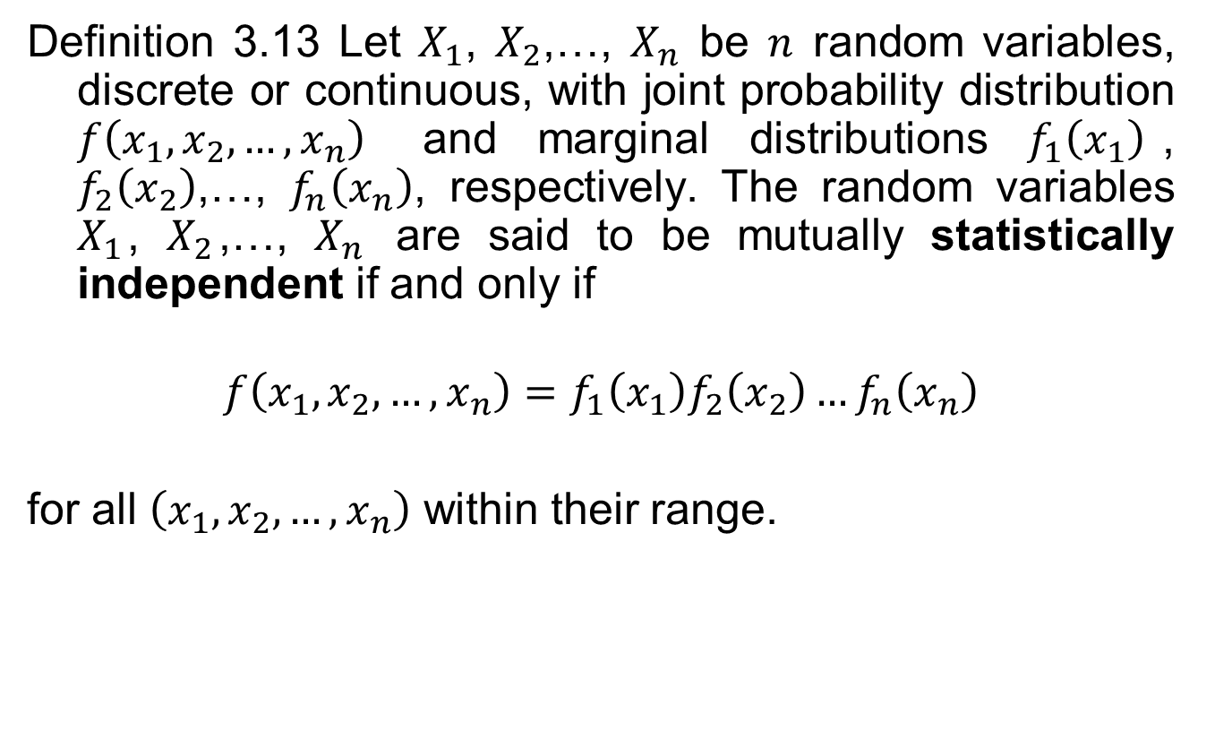
Statistical Independence
Definition 3.13 Let $X_{1}$, $X_{2}$,…, $X_{n}$ be $n$ random variables, discrete or continuous, with joint probability distribution $f\left(x_{1}, x_{2},…, x_{n}\right)$ and marginal distributions $f_{1}\left(x_{1}\right)$, $f_{2}\left(x_{2}\right)$,…, $f_{n}\left(x_{n}\right)$, respectively. The random variables $X_{1}$, $X_{2}$,…, $X_{n}$ are said to be mutually statistically independent if and only if
$$f\left(x_{1}, x_{2},…, x_{n}\right)=f_{1}\left(x_{1}\right)f_{2}\left(x_{2}\right)…f_{n}\left(x_{n}\right)$$
for all $\left(x_{1},x_{2},…, x_{n}\right)$ within their range.

Slide 15
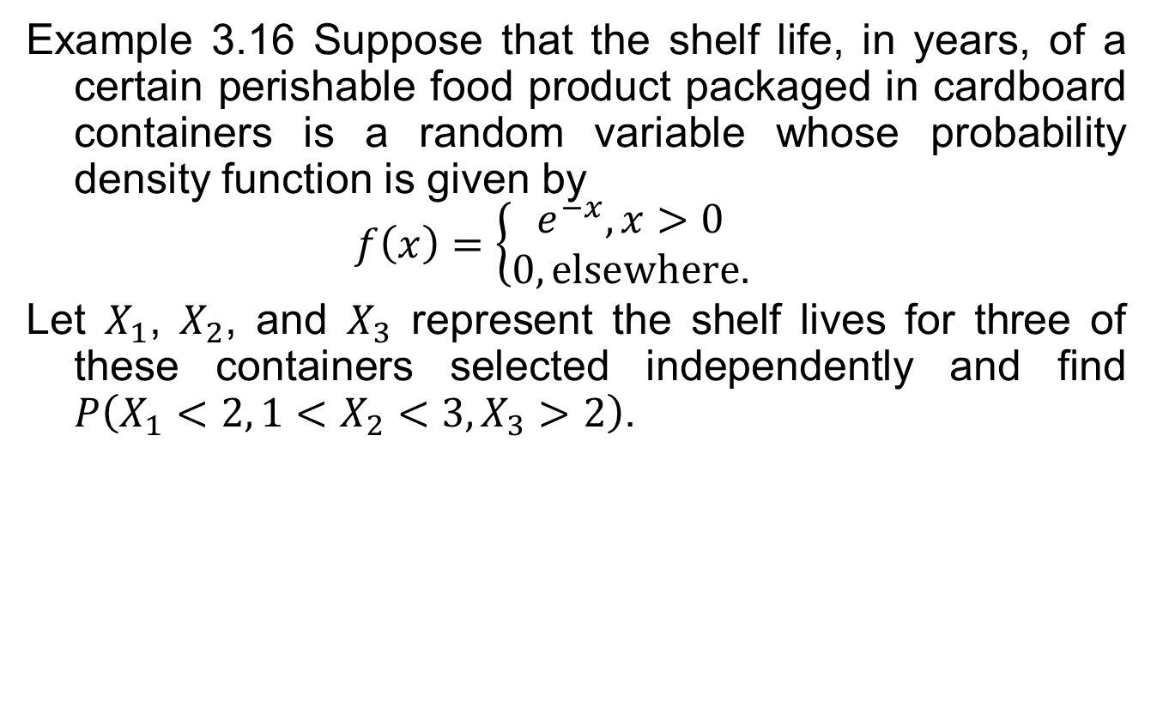
Statistical Independence
Example 3.16 Suppose that the shelf life, in years, of a certain perishable food product packaged in cardboard containers is a random variable whose probability density function is given by
$$f\left(x\right)=\left\{\begin{aligned}e^{−x}, x>0 \\ 0, elsewhere.\end{aligned}\right.$$
Let $X_{1}$, $X_{2}$, and $X_{3}$ represent the shelf lives for three of these containers selected independently and find $P\left(X_{1}<2, 1<X_{2}<3, X_{3}>2\right)$.

Slide 16
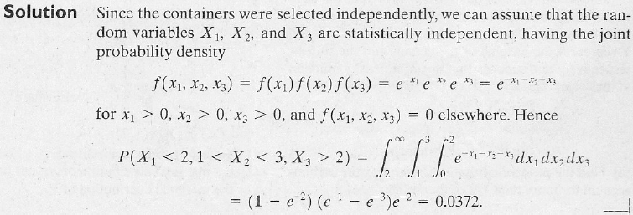
Statistical Independence

